Slide 1
Weekly Meeting
차량 임베디드 소프트웨어 실험실
안솔

Slide 2
실제 실험 진행 상황
 | YOLOv7-tiny | DenseNet | EfficienNet | YOLOv7 | ResNet | MobileNet | SqueezeNet | YOLOv2-tiny (16개) | ReseNet10 (17개)
Seq (Full CPU & GPU) | O | O | O | O | O | O | O | O | O
Tpa (Full CPU & GPU) | O | O | O | O | O | O | O | O | O
Dpa (Full CPU & GPU) | O | O | O | O | O | O | O | O | O
GPU [0, M] | O | O | O | O | O | O | O | O | O
GPU [start, M] | - | O | - | - | - | - | - | O | O
GPU [Full freedom] | - | 100개 set만 진행 예정 | - | - | - | - | - | 시뮬레이션 가능
Reclaiming | - | O | - | - | - | - | - | - | -

Slide 3
Toy Model
3가지 대표 타입 별로 Layer 10개인 모델
(e_preprocess, e_postprocess = 10ms)

Slide 4
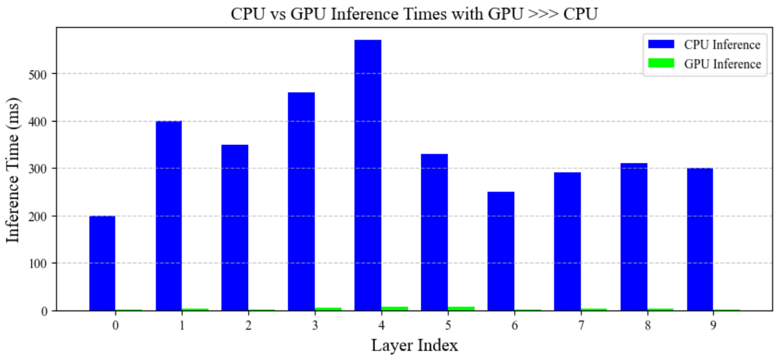
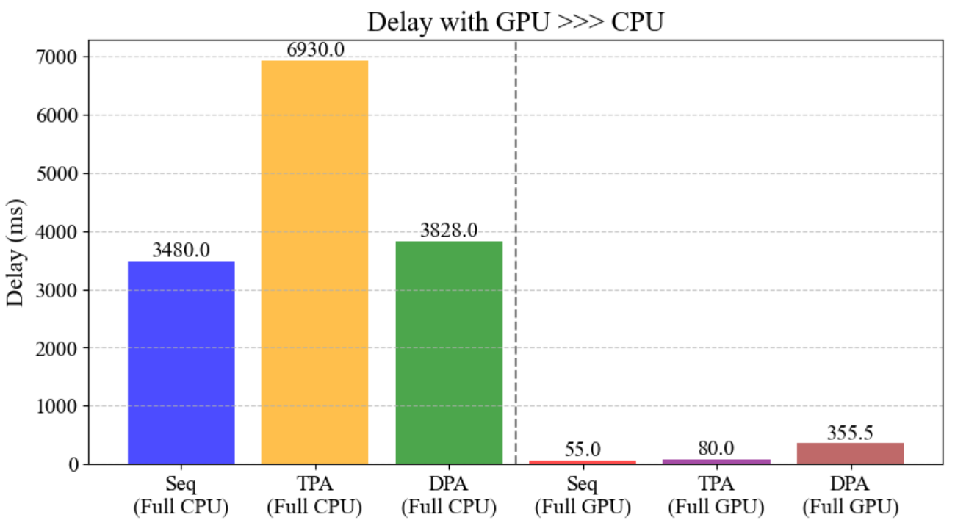
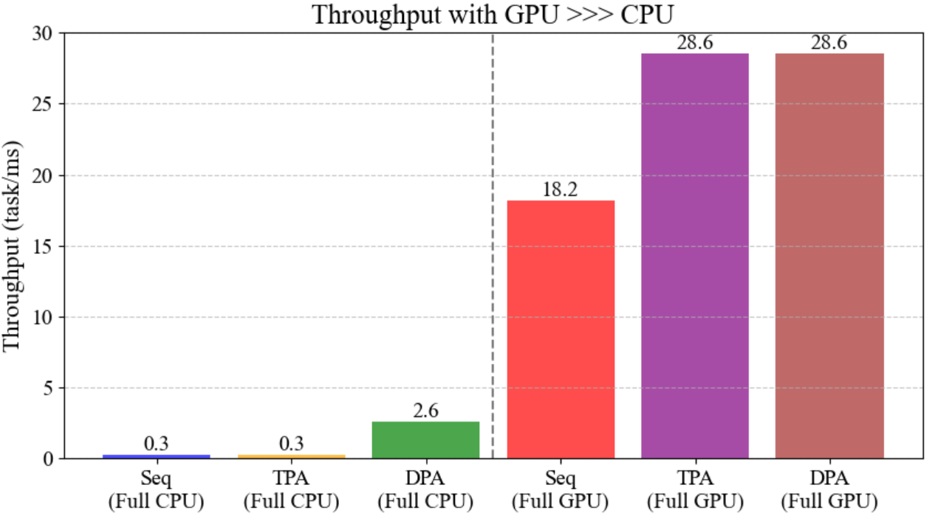
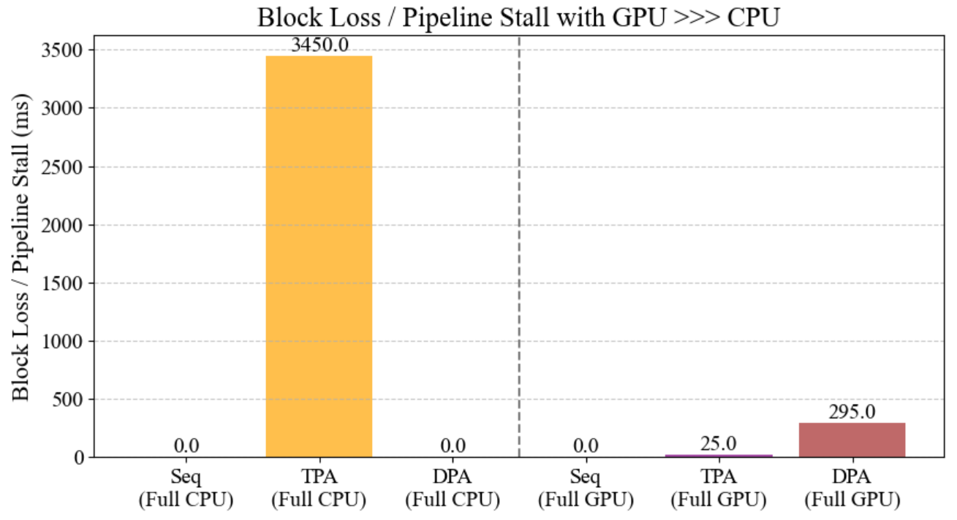
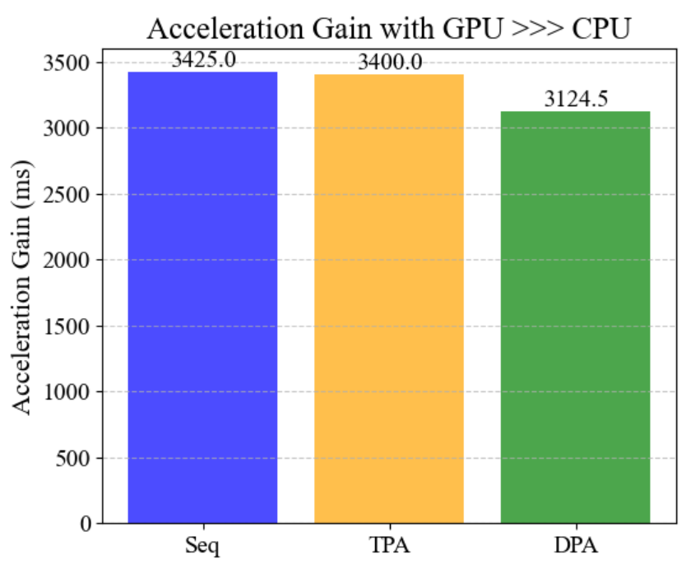
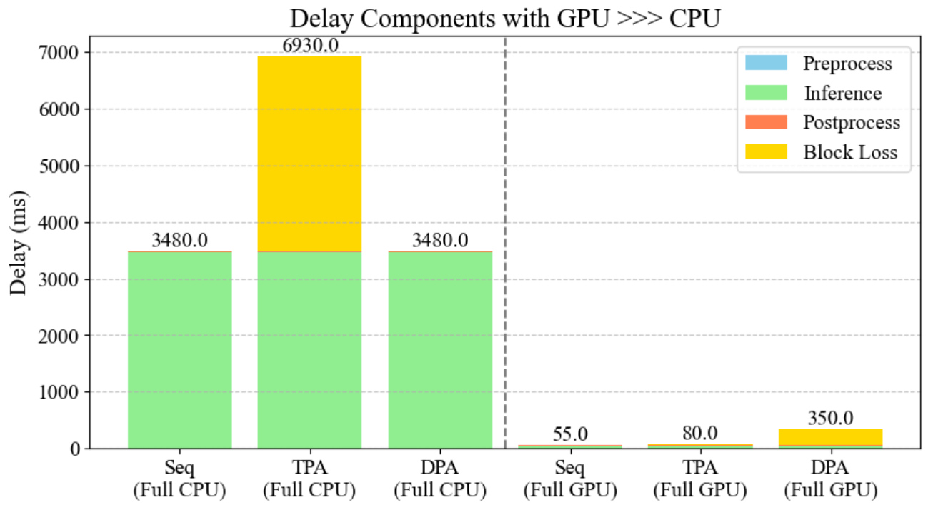
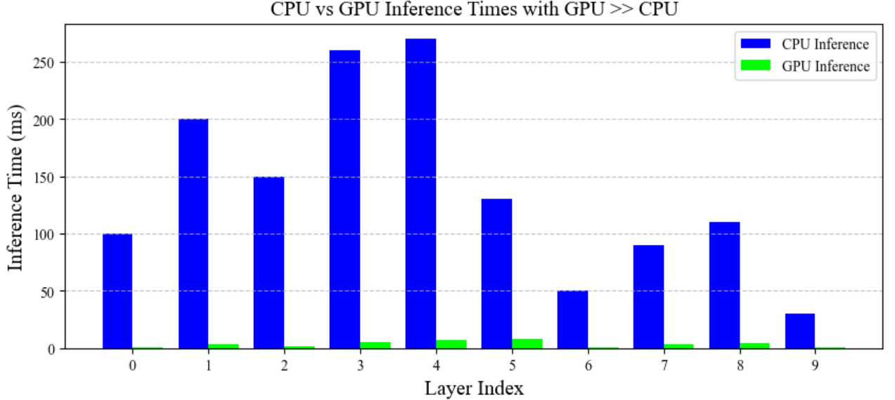
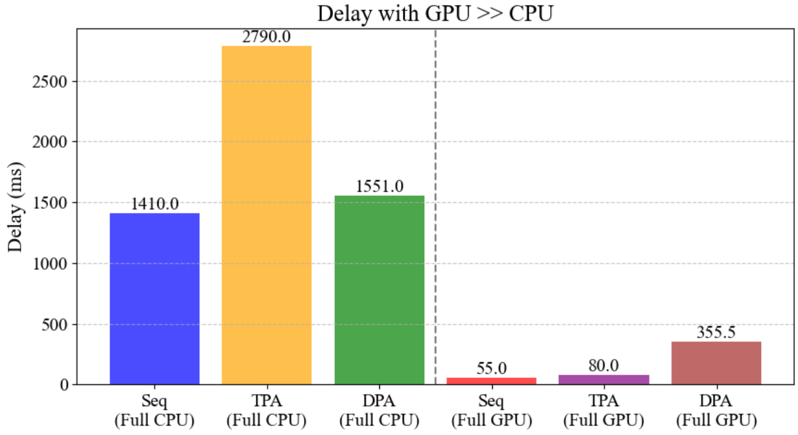
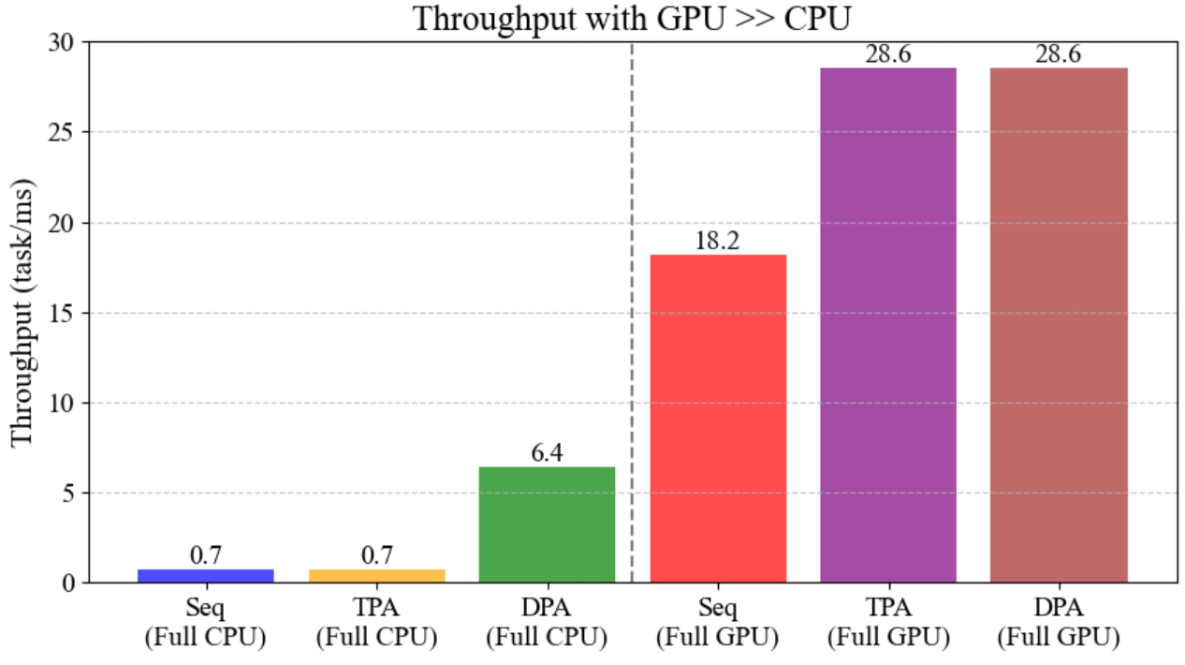
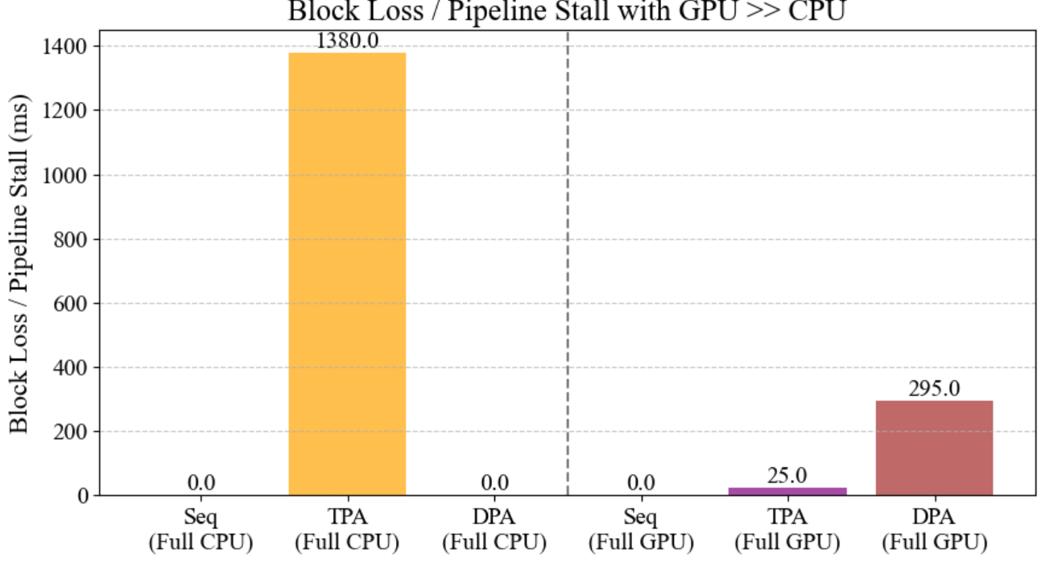
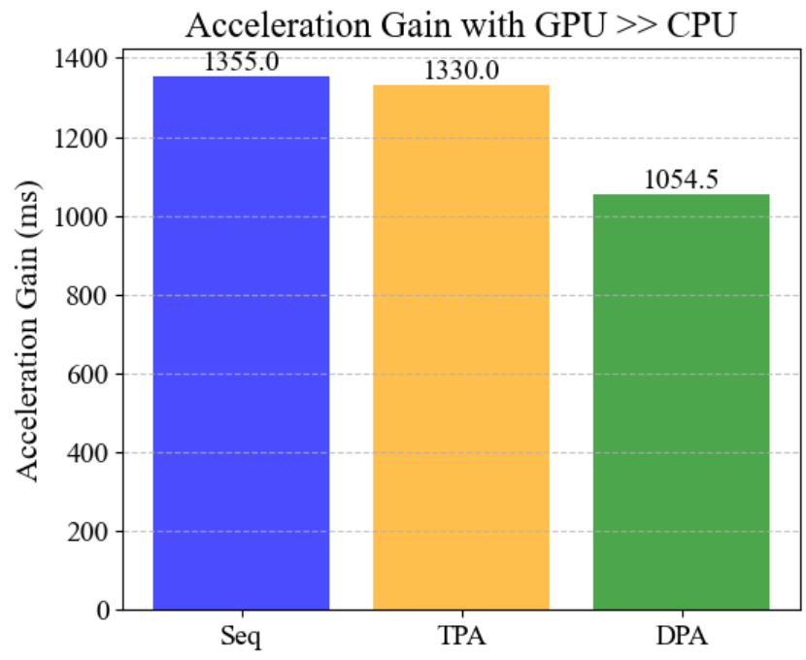
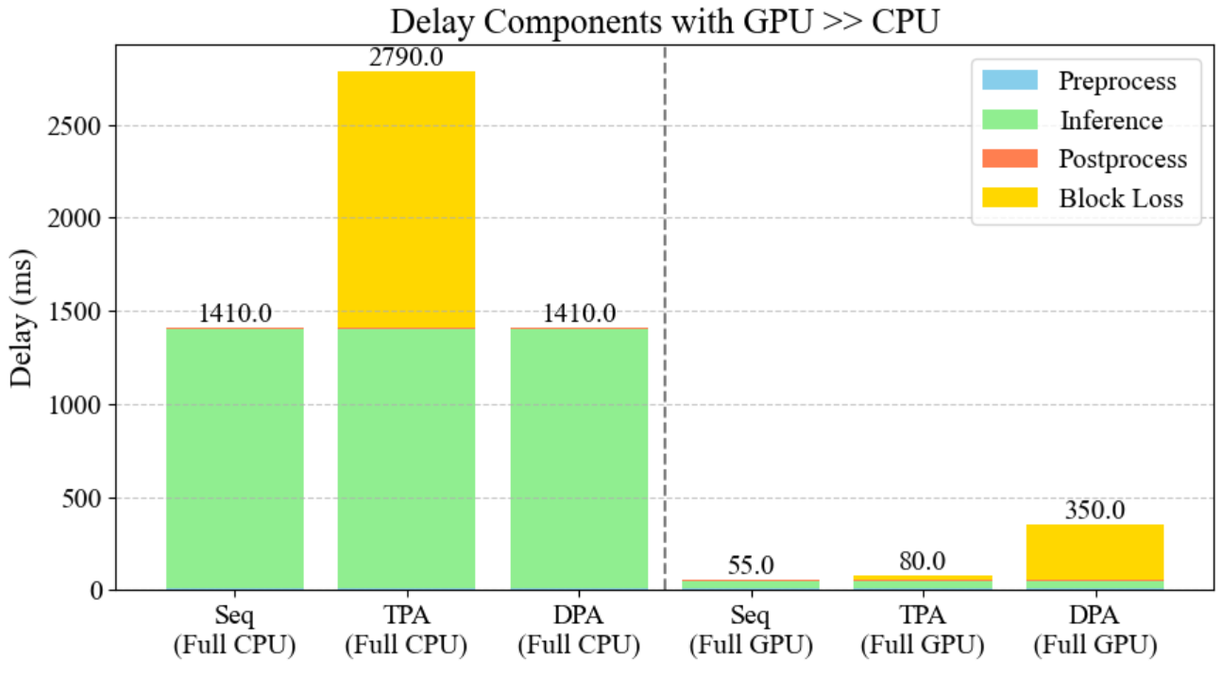
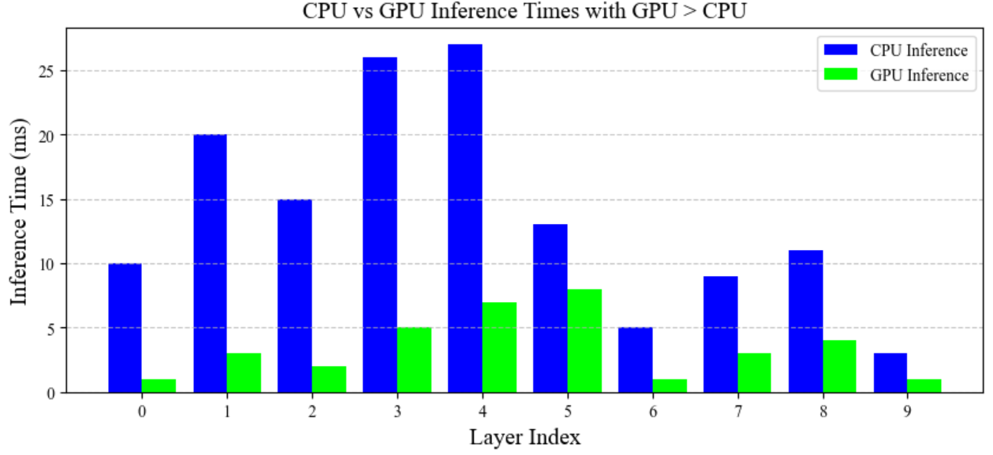
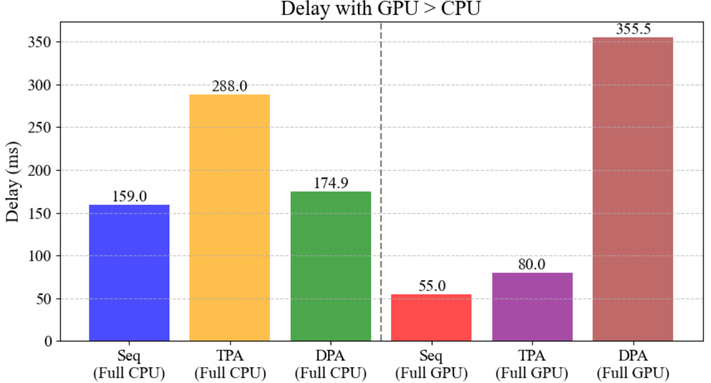
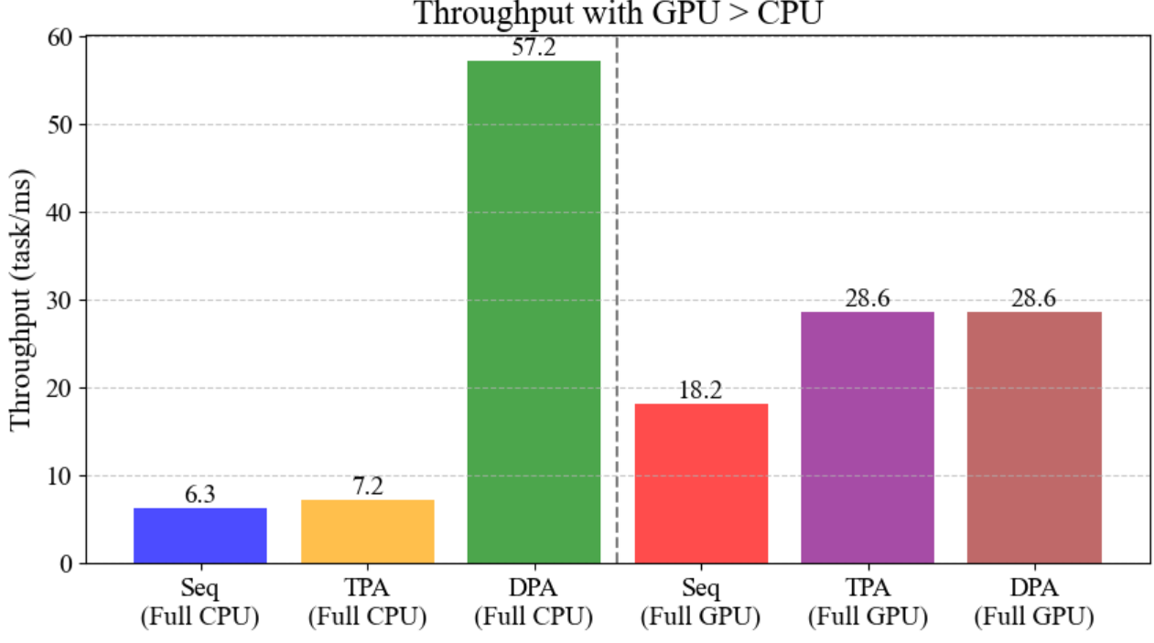
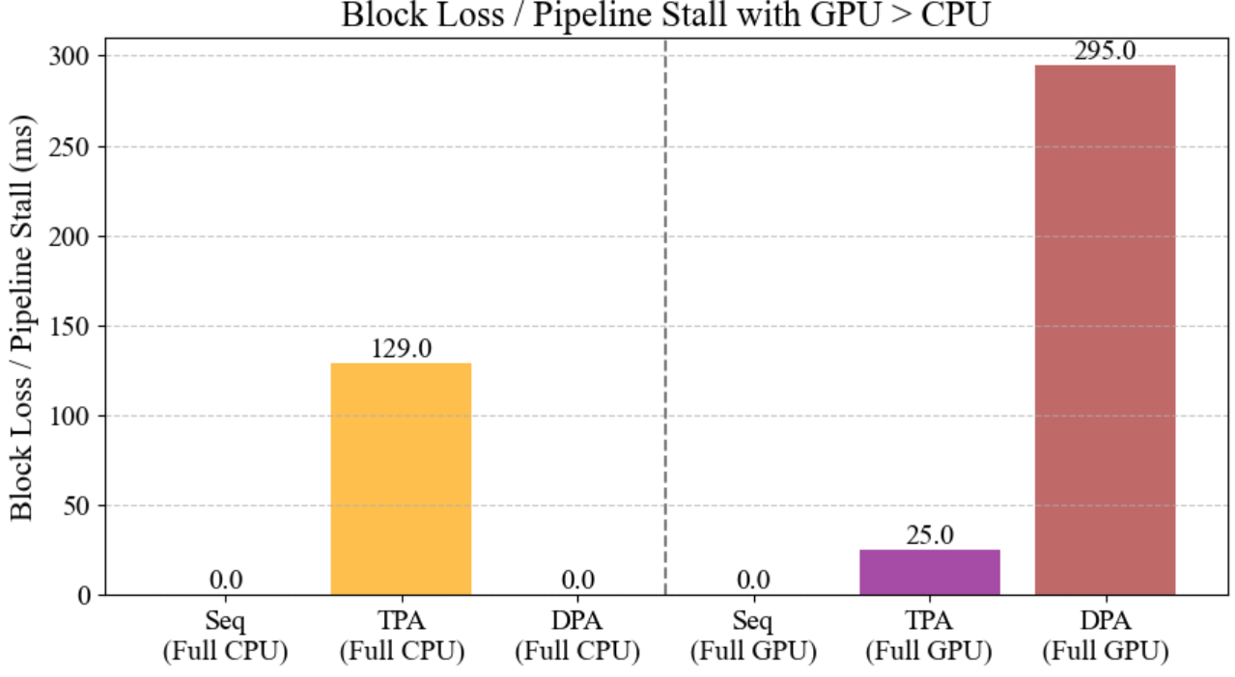
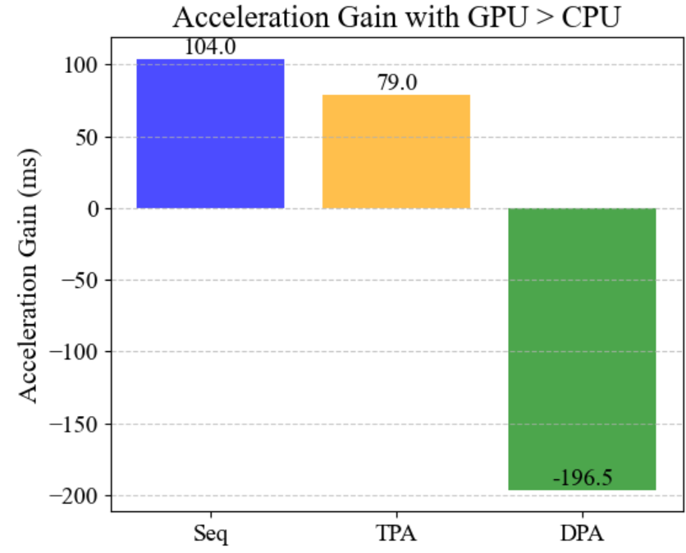
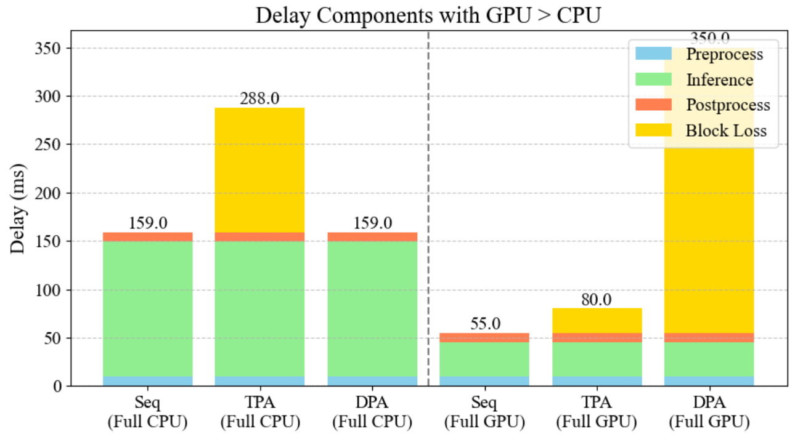
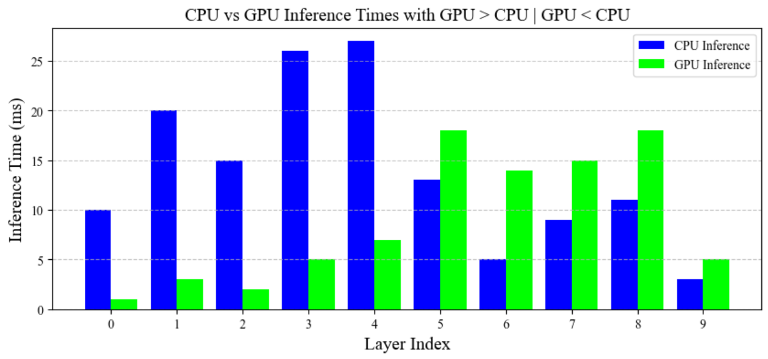
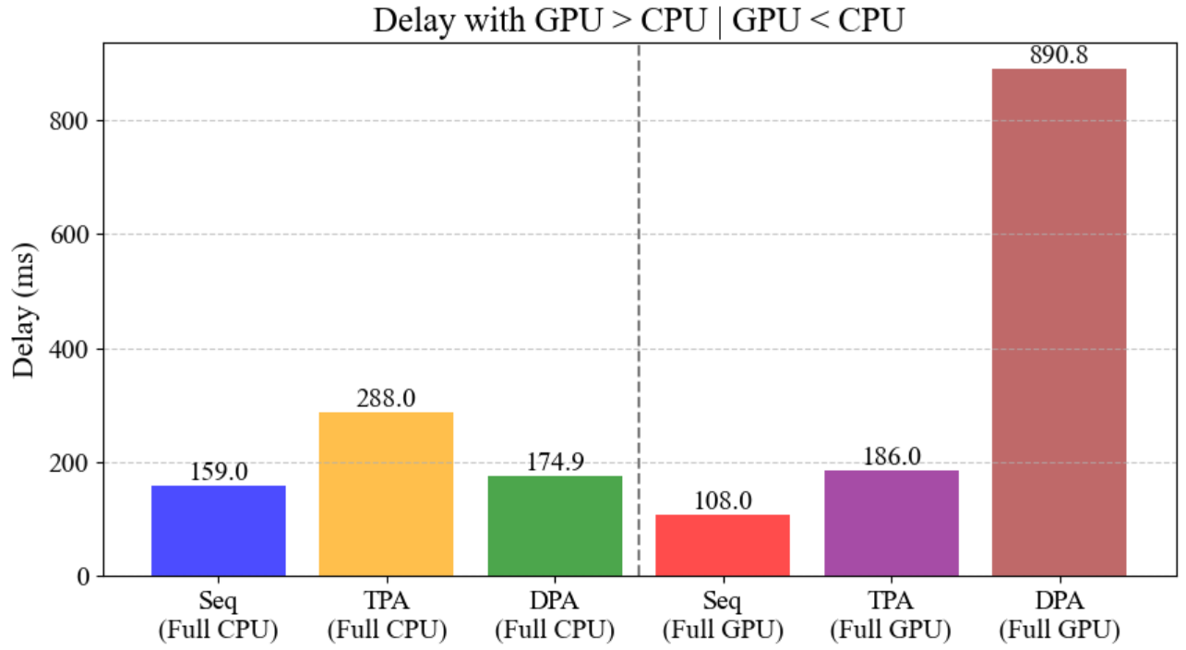
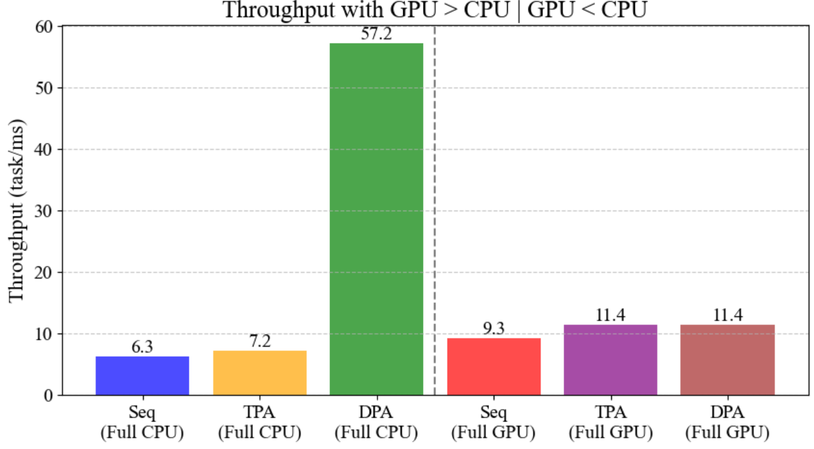
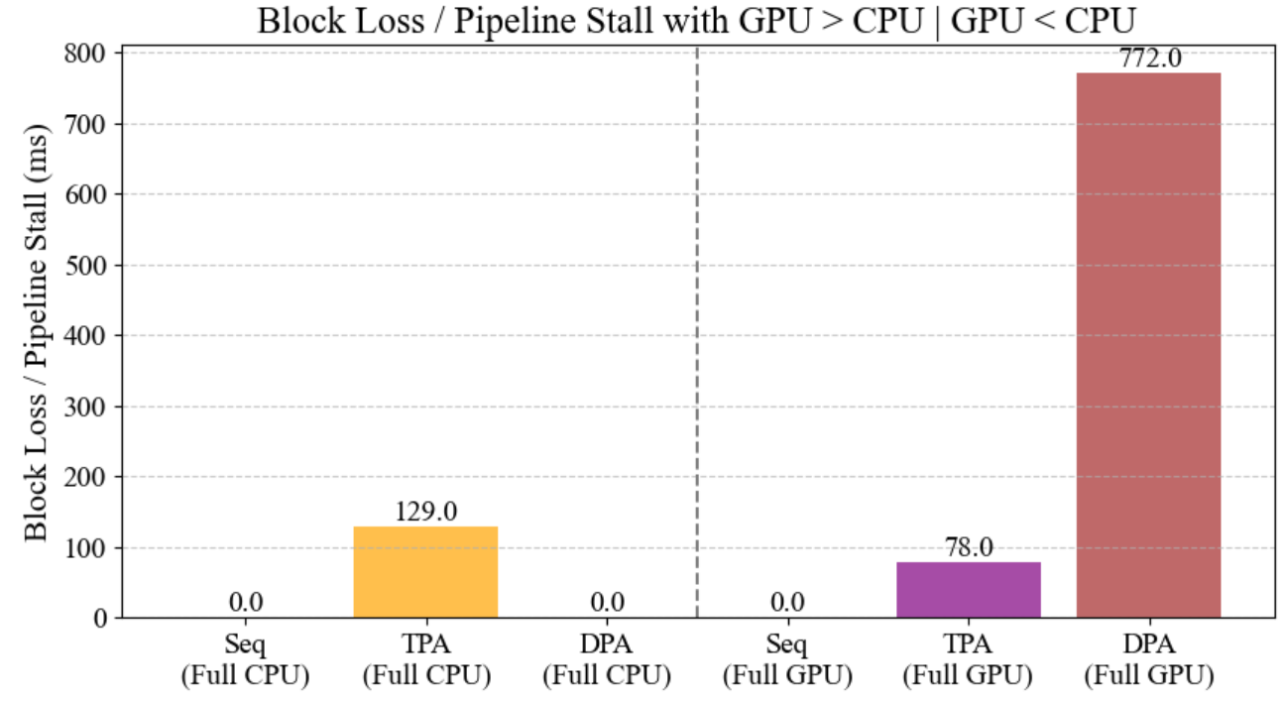
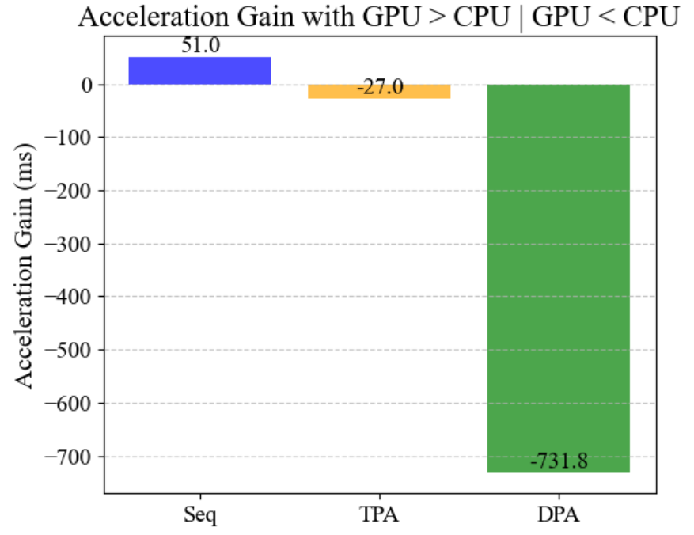
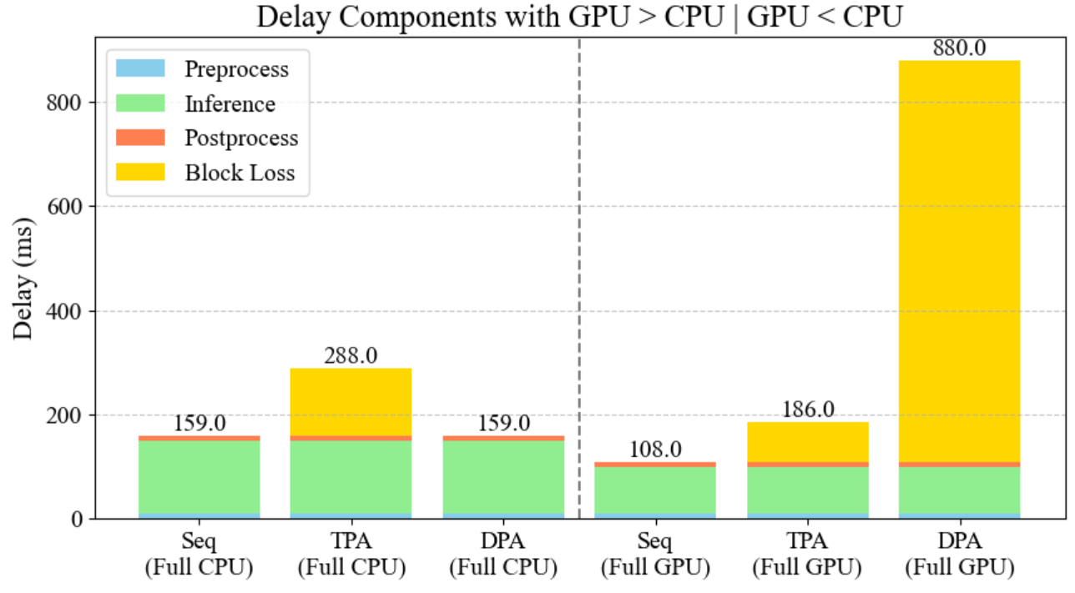
Seq, Tpa, Dpa
Orin
Toy Model
GPU >>> CPU
GPU >> CPU
GPU > CPU
GPU > CPU | GPU < CPU

Slide 5
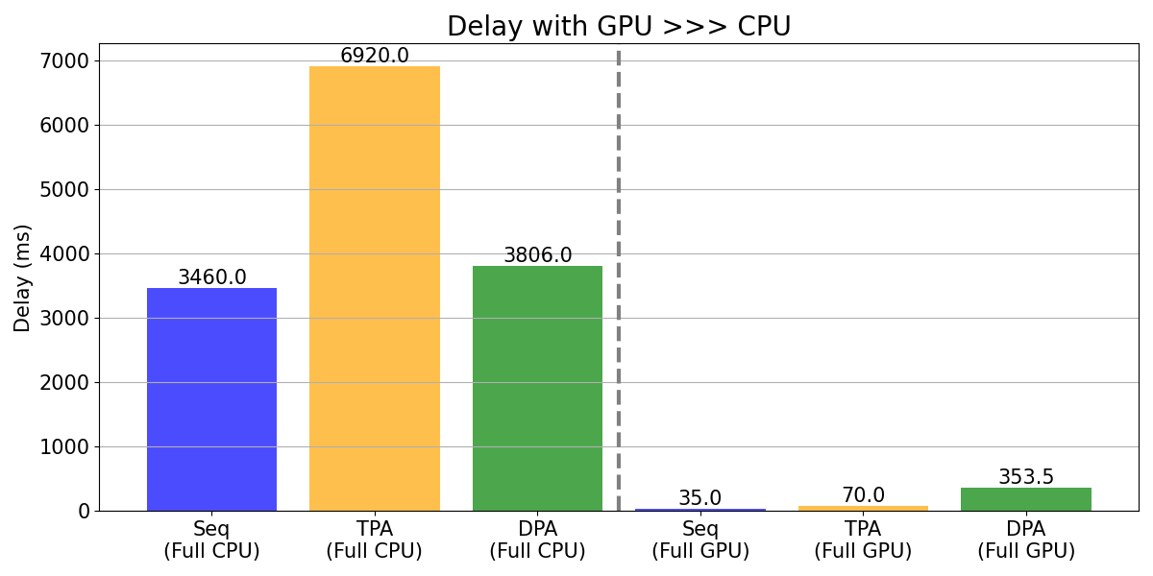
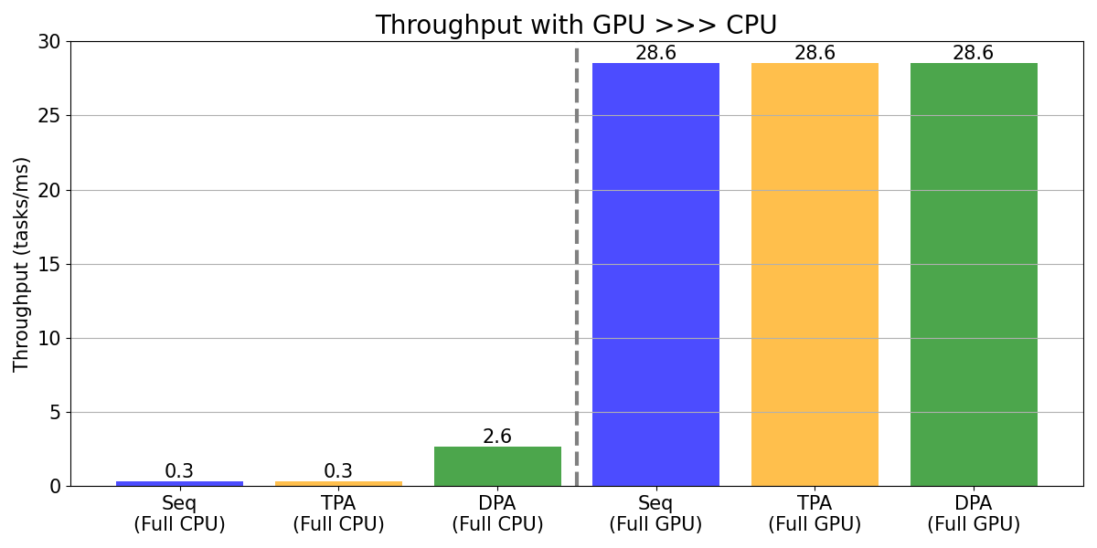
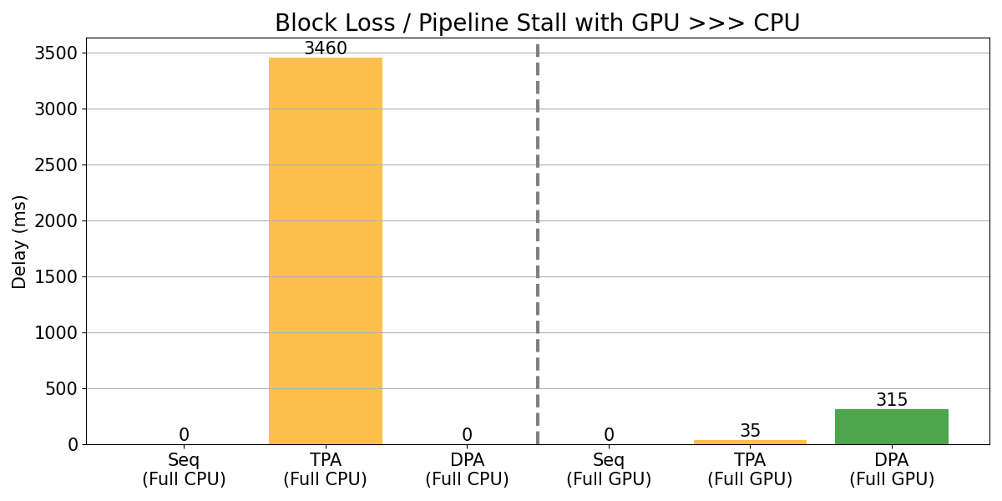
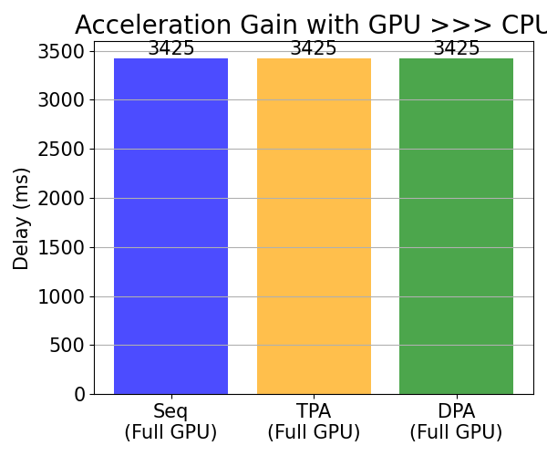
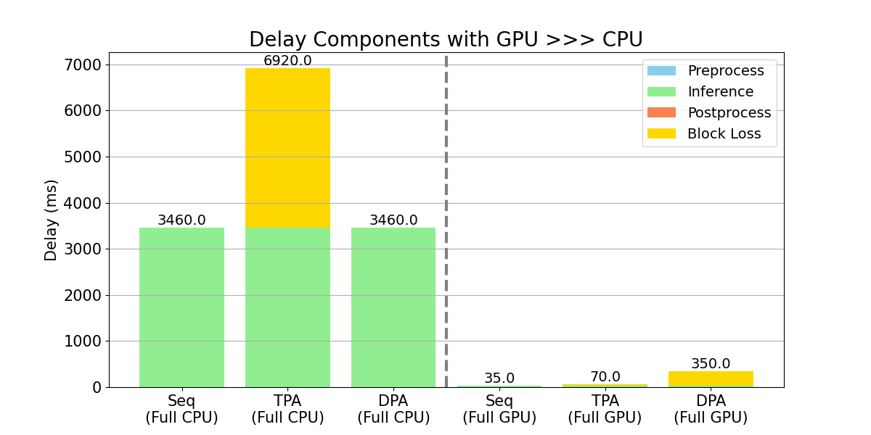
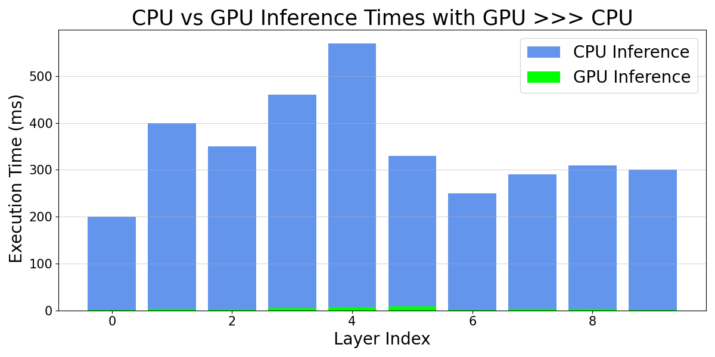
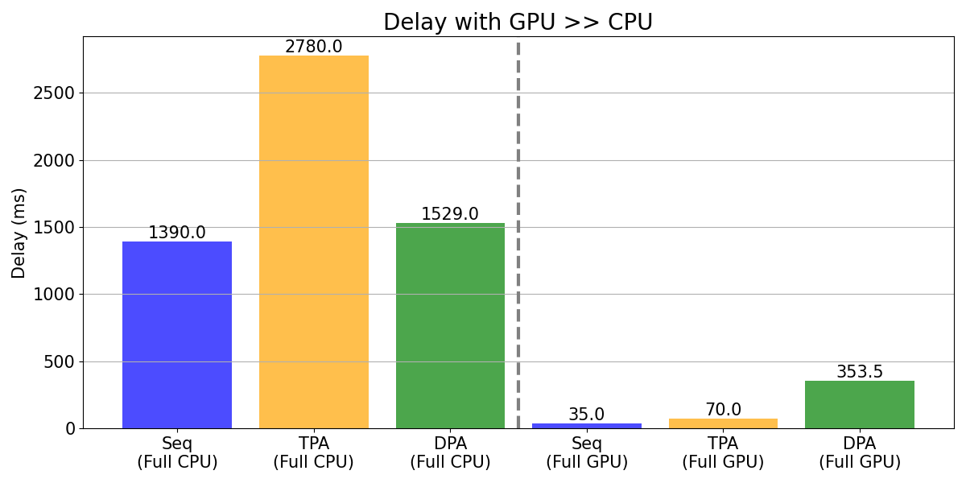
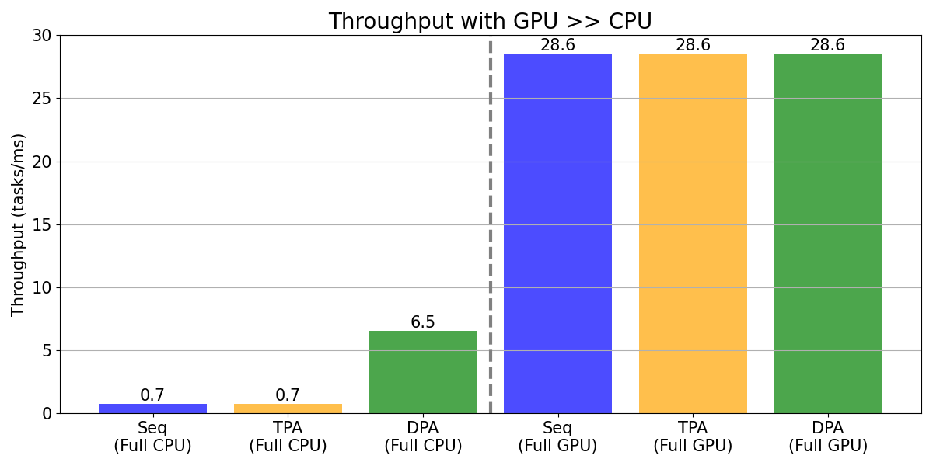
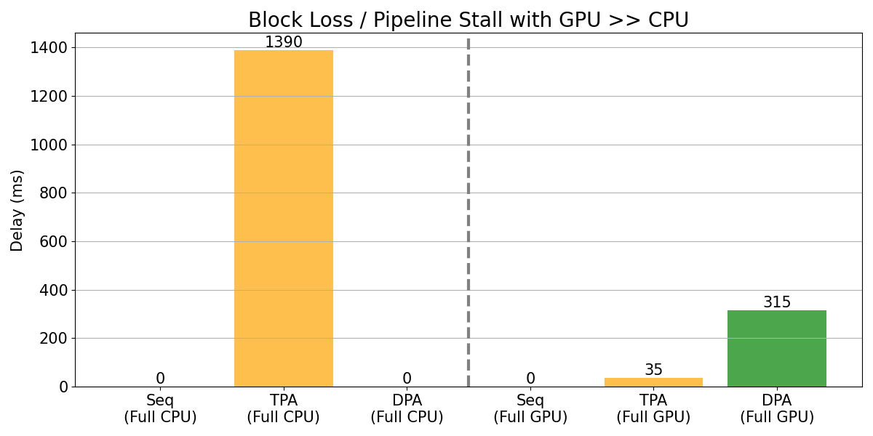
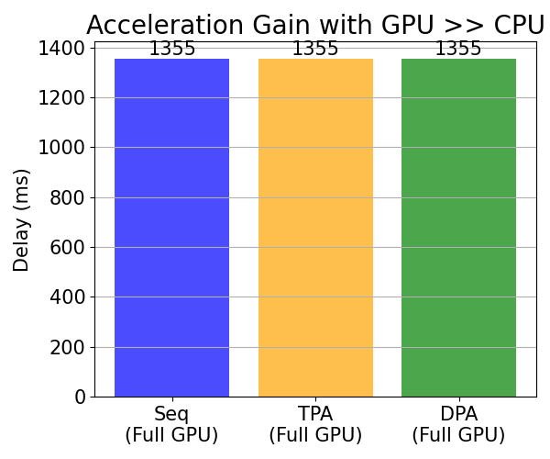
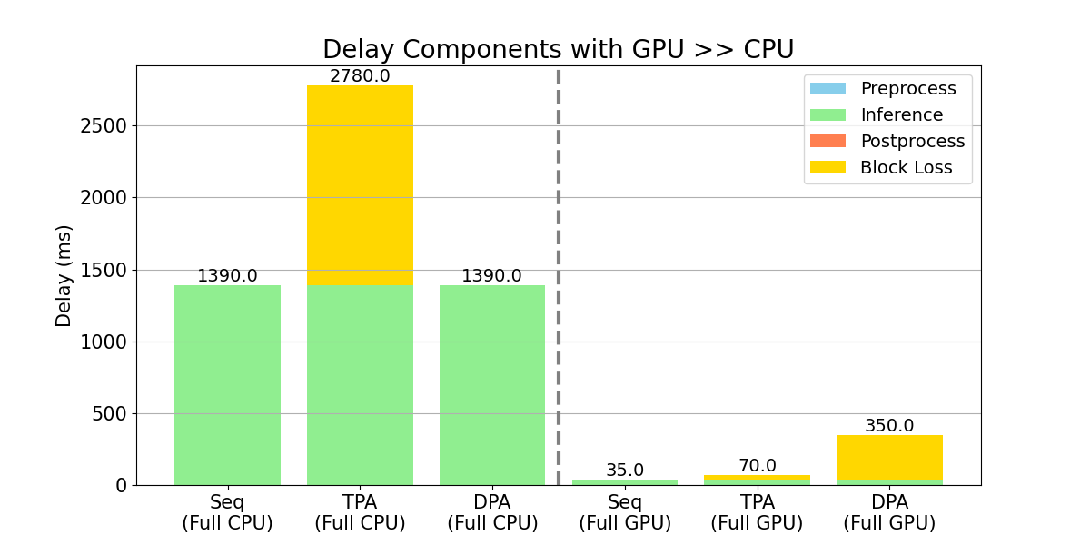
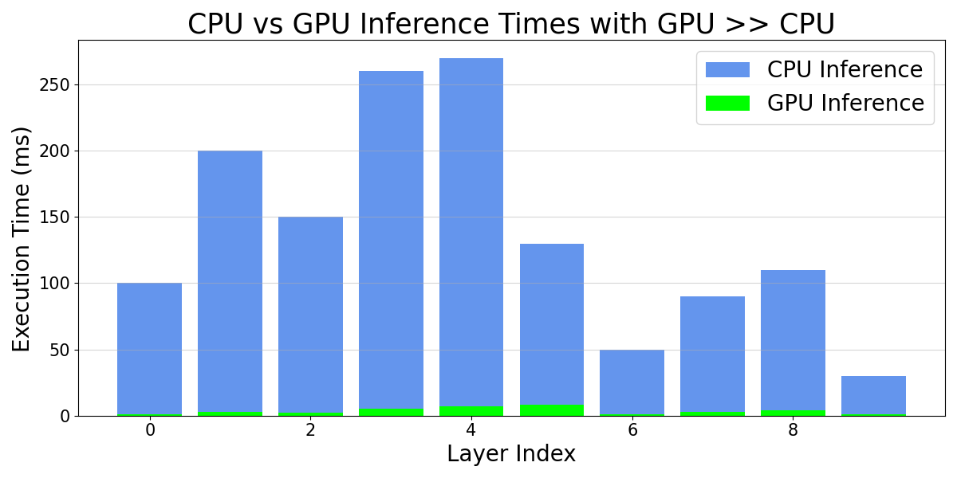
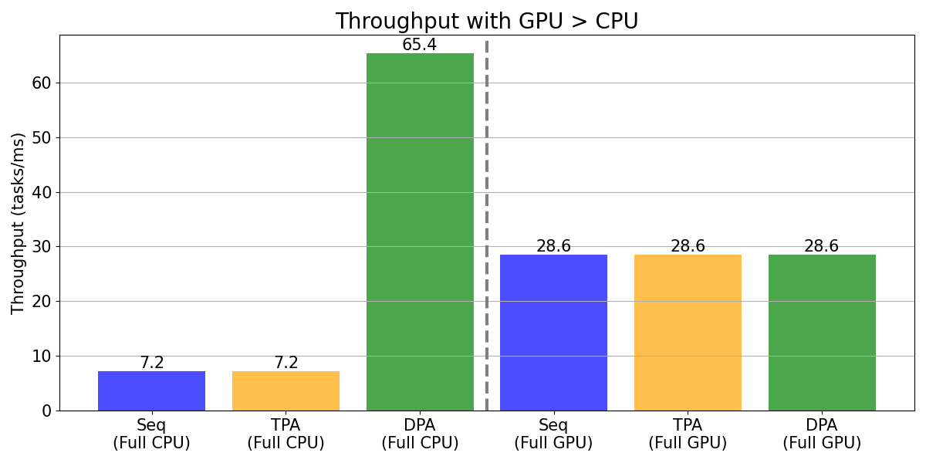
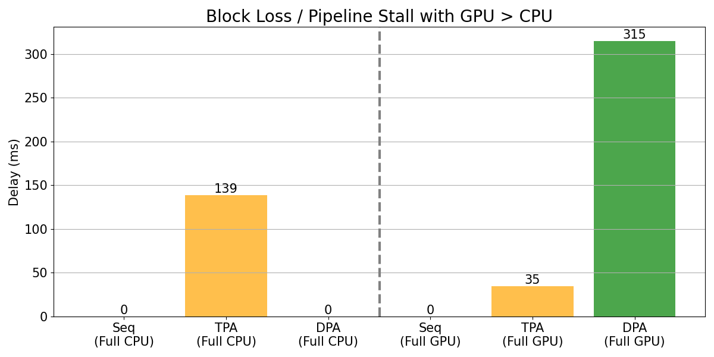
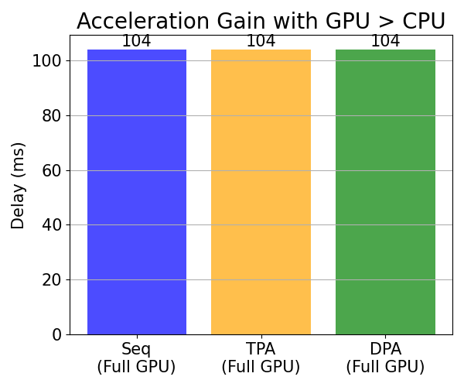
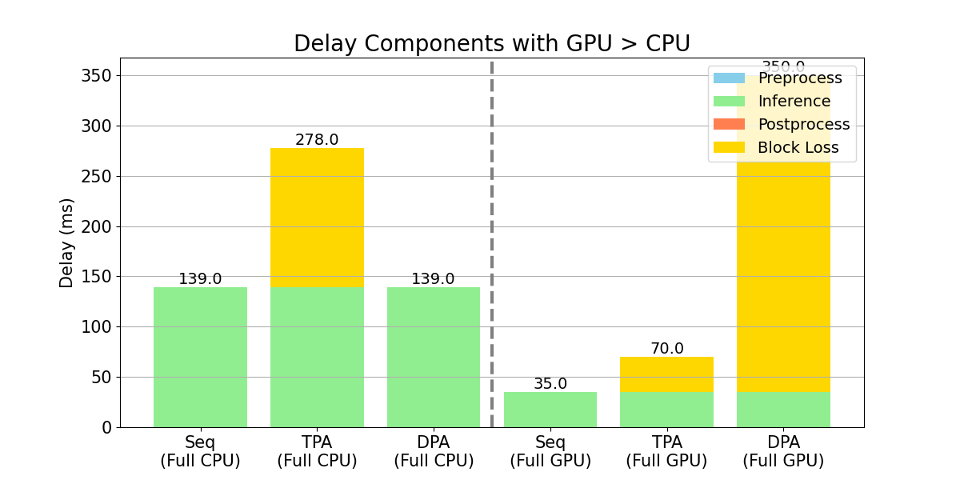
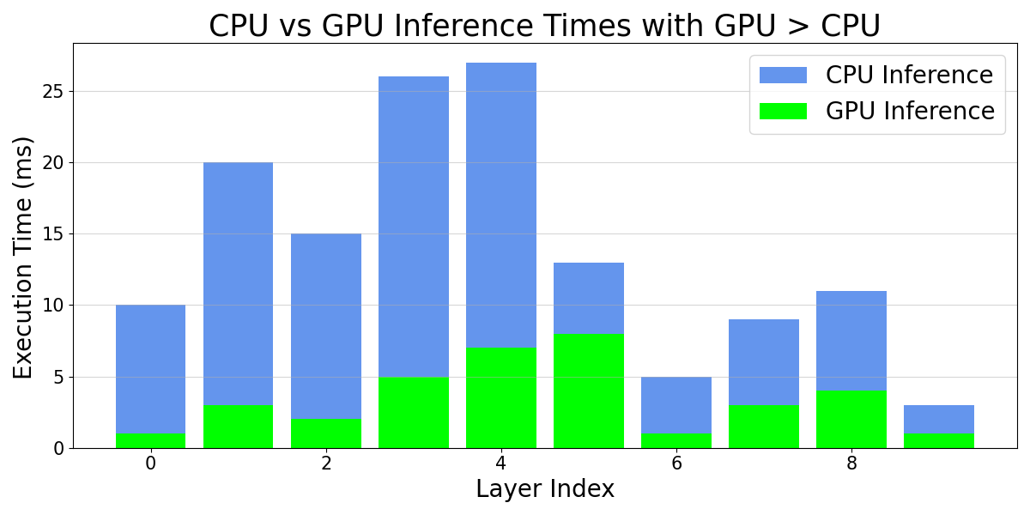
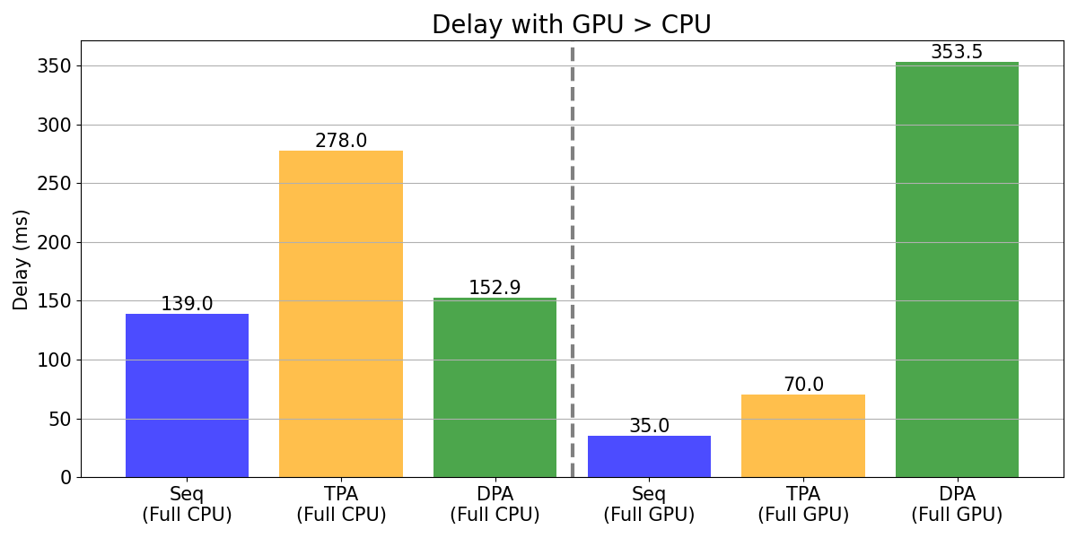
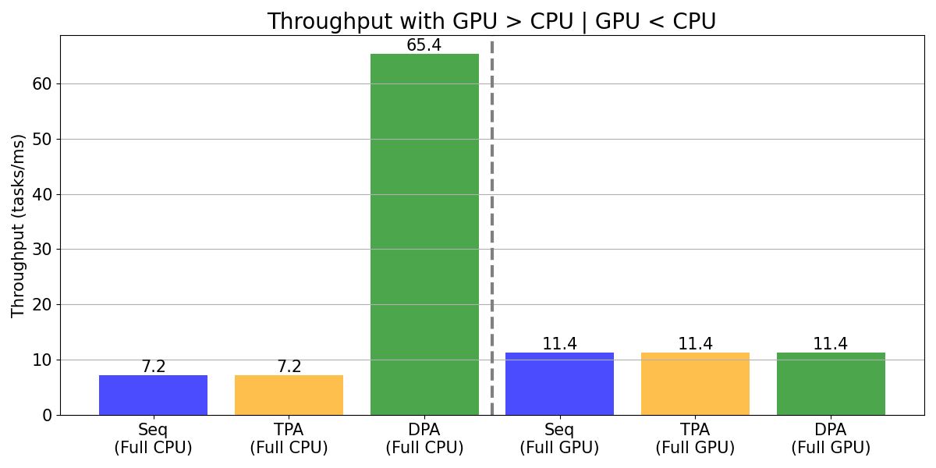
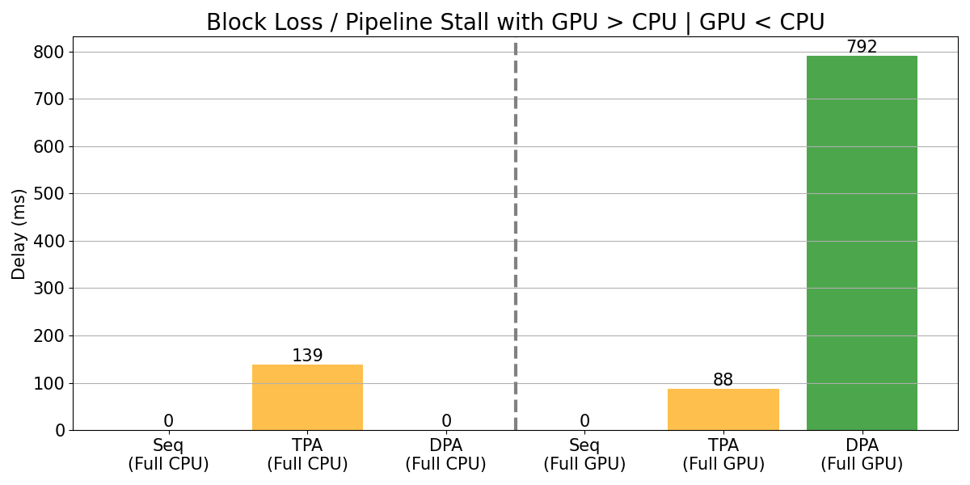
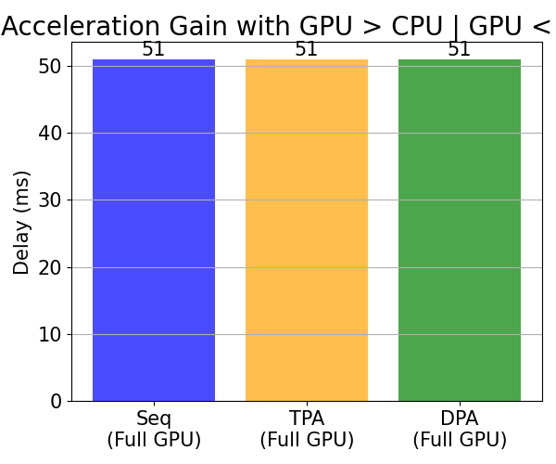
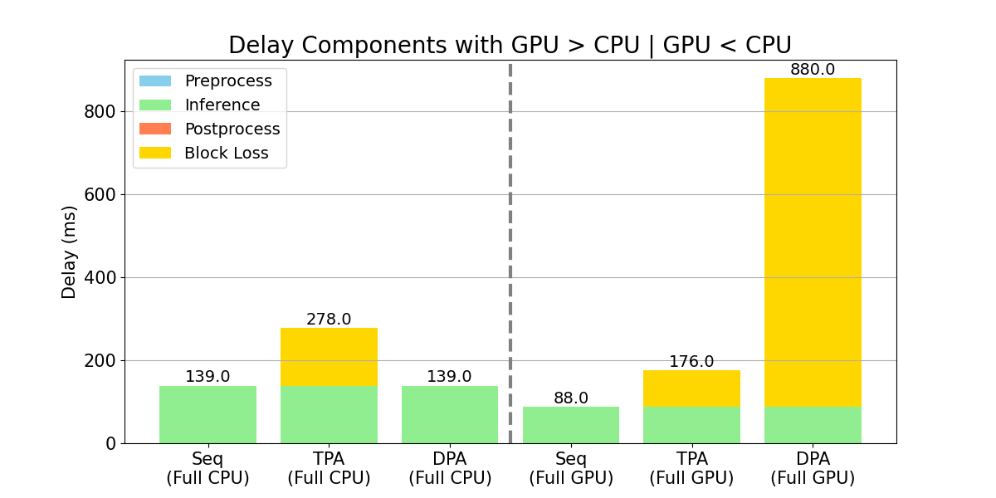
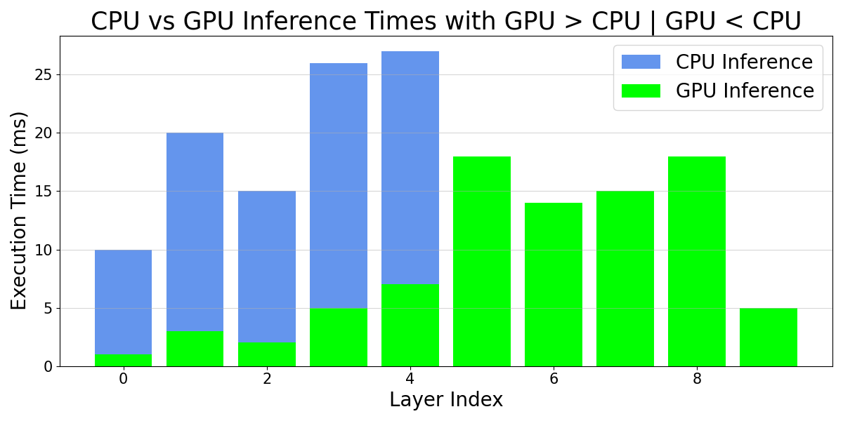
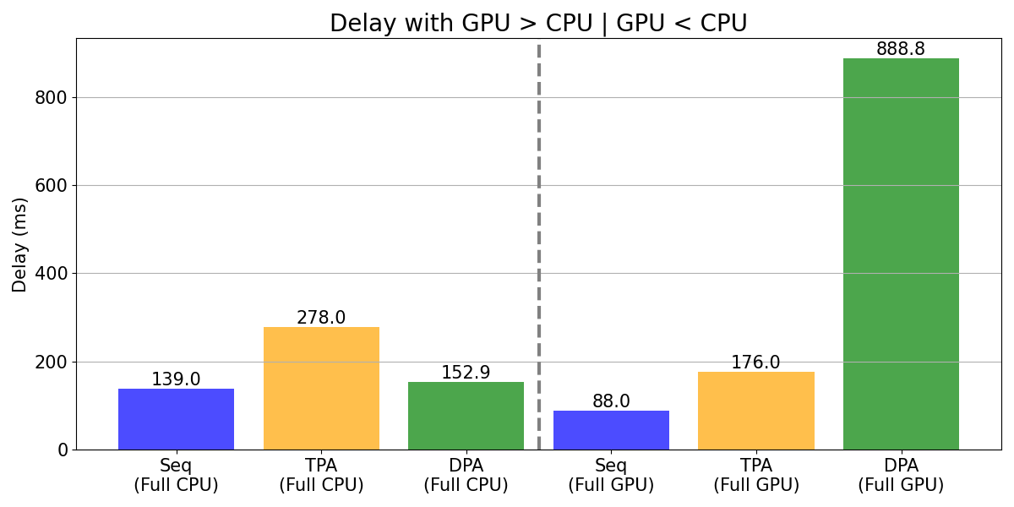
Seq, Tpa, Dpa
Nano
Toy Model
GPU >>> CPU
GPU >> CPU
GPU > CPU
GPU > CPU | GPU < CPU

Slide 6
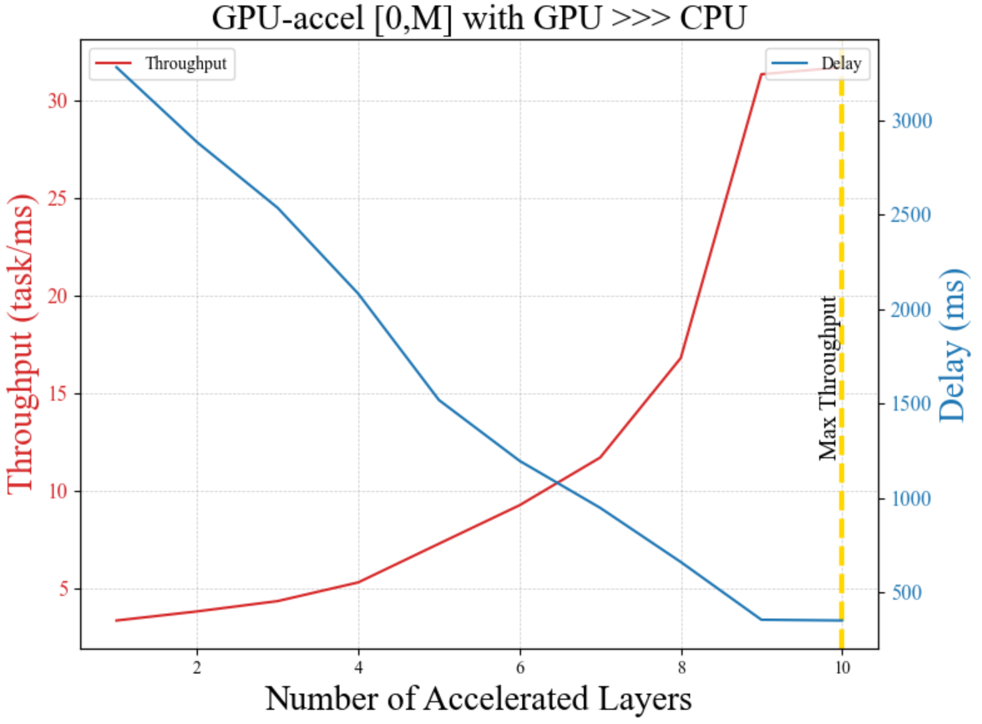
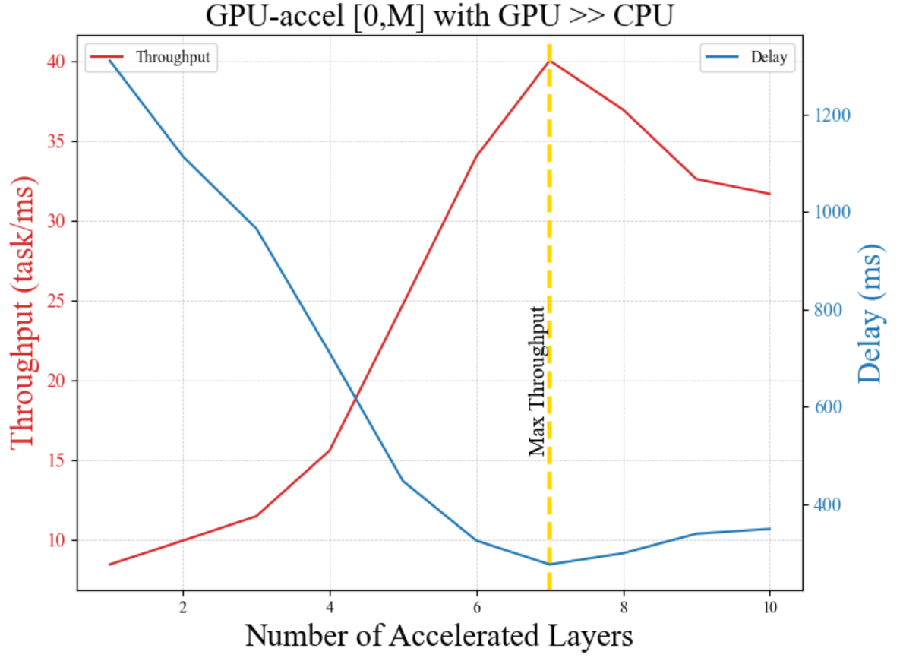










Gpu-accel [0, M] (N_thread = 10)
Toy Model
GPU >>> CPU
GPU >> CPU
GPU > CPU
GPU > CPU | GPU < CPU

Slide 7












Gpu-accel [0, M] (N_thread = 20)
Toy Model
GPU >>> CPU
GPU >> CPU
GPU > CPU
GPU > CPU | GPU < CPU

Slide 8








Gpu-accel [0, M] (N_thread = 10)
Toy Model
GPU >>> CPU
GPU >> CPU
GPU > CPU
GPU > CPU | GPU < CPU

Slide 9








Gpu-accel [start, M] (N_thread = 10)
TODO
Toy Model
GPU >>> CPU
GPU >> CPU
GPU > CPU
GPU > CPU | GPU < CPU

Slide 10








Gpu-accel [start, M] (N_thread = 10)
TODO
Toy Model
GPU >>> CPU
GPU >> CPU
GPU > CPU
GPU > CPU | GPU < CPU

Slide 11








Gpu-accel [Full freedom]
TODO
Toy Model
GPU >>> CPU
GPU >> CPU
GPU > CPU
GPU > CPU | GPU < CPU

Slide 12












Gpu-accel [Full freedom]
TODO
Toy Model
GPU >>> CPU
GPU >> CPU
GPU > CPU
GPU > CPU | GPU < CPU

Slide 13








Gpu-accel [Full freedom]
TODO
Toy Model
GPU >>> CPU
GPU >> CPU
GPU > CPU
GPU > CPU | GPU < CPU

Slide 14
Idle CPU cores reclaiming
TODO
Toy Model
솔

Slide 15
ILP Optimization
TODO
Toy Model
솔

Slide 16
Real Model
3가지 대표 타입 별로 실제 모델

Slide 17


















Seq, Tpa, Dpa
Real Model
(Seq기반 시뮬레이션)
Orin
YOLOv7-tiny (GPU >>> CPU)
DenseNet201 (GPU >> CPU)
EfficientNet (GPU > CPU | GPU < CPU)

Slide 18







Seq, Tpa, Dpa
Real Model
(Seq기반 시뮬레이션)
Nano
YOLOv7-tiny (GPU >>> CPU)
DenseNet201 (GPU >> CPU)
EfficientNet (GPU > CPU | GPU < CPU)

Slide 19






Seq, Tpa, Dpa
+ Energy consumption
Real Model
Orin
YOLOv7-tiny (GPU >>> CPU)
DenseNet201 (GPU >> CPU)
EfficientNet (GPU > CPU | GPU < CPU)

Slide 20





Seq, Tpa, Dpa
Nano
+ Energy consumption
Real Model
YOLOv7-tiny (GPU >>> CPU)
앞에랑 동일?
DenseNet201 (GPU >> CPU)
EfficientNet (GPU > CPU | GPU < CPU)

Slide 21









Gpu-accel [0, M]
Real Model
(Seq기반 시뮬레이션)
YOLOv7-tiny (GPU >>> CPU)
DenseNet201 (GPU >> CPU)
EfficientNet (GPU > CPU | GPU < CPU)

Slide 22



Gpu-accel [0, M]
Real Model
(Seq기반 시뮬레이션)
Nano
YOLOv7-tiny (GPU >>> CPU)
DenseNet201 (GPU >> CPU)
EfficientNet (GPU > CPU | GPU < CPU)

Slide 23






Gpu-accel [0, M]
Real Model
(Seq기반 시뮬레이션)
YOLOv7-tiny (GPU >>> CPU)
DenseNet201 (GPU >> CPU)
EfficientNet (GPU > CPU | GPU < CPU)

Slide 24


Gpu-accel [0, M]
Real Model
(Seq기반 시뮬레이션)
Nano
YOLOv7-tiny (GPU >>> CPU)
DenseNet201 (GPU >> CPU)
EfficientNet (GPU > CPU | GPU < CPU)

Slide 25



Gpu-accel [0, M]
Real Model
YOLOv7-tiny (GPU >>> CPU)
DenseNet201 (GPU >> CPU)
EfficientNet (GPU > CPU | GPU < CPU)

Slide 26

Gpu-accel [0, M]
Nano
Real Model
TODO
YOLOv7-tiny (GPU >>> CPU)
DenseNet201 (GPU >> CPU)
EfficientNet (GPU > CPU | GPU < CPU)
TODO
TODO
TODO

Slide 27
[TODO]
19번 슬라이드에 대응되는
Real – Exp 그래프 만들기

Slide 28



Gpu-accel [0, M]
Real Model
YOLOv7-tiny (GPU >>> CPU)
DenseNet201 (GPU >> CPU)
EfficientNet (GPU > CPU | GPU < CPU)

Slide 29
Gpu-accel [0, M]
Nano
Real Model
TODO
YOLOv7-tiny (GPU >>> CPU)
DenseNet201 (GPU >> CPU)
EfficientNet (GPU > CPU | GPU < CPU)
TODO

Slide 30






Gpu-accel [start, M]
Real Model
(Seq기반 시뮬레이션)
TODO
YOLOv7-tiny (GPU >>> CPU)
DenseNet201 (GPU >> CPU)
EfficientNet (GPU > CPU | GPU < CPU)

Slide 31






Gpu-accel [start, M]
Real Model
(Seq기반 시뮬레이션)
TODO
YOLOv7-tiny (GPU >>> CPU)
DenseNet201 (GPU >> CPU)
EfficientNet (GPU > CPU | GPU < CPU)

Slide 32






Gpu-accel [start, M]
Real Model
(Seq기반 시뮬레이션)
TODO
YOLOv7-tiny (GPU >>> CPU)
DenseNet201 (GPU >> CPU)
EfficientNet (GPU > CPU | GPU < CPU)

Slide 33






Gpu-accel [start, M]
Real Model
(Seq기반 시뮬레이션)
TODO
YOLOv7-tiny (GPU >>> CPU)
DenseNet201 (GPU >> CPU)
EfficientNet (GPU > CPU | GPU < CPU)

Slide 34















Gpu-accel [start, M]
TODO
Real Model
YOLOv7-tiny (GPU >>> CPU)
DenseNet201 (GPU >> CPU)
EfficientNet (GPU > CPU | GPU < CPU)

Slide 35






Gpu-accel [start, M]
TODO
Real Model
YOLOv7-tiny (GPU >>> CPU)
DenseNet201 (GPU >> CPU)
EfficientNet (GPU > CPU | GPU < CPU)

Slide 36









Gpu-accel [start, M]
TODO
Real Model
YOLOv7-tiny (GPU >>> CPU)
DenseNet201 (GPU >> CPU)
EfficientNet (GPU > CPU | GPU < CPU)

Slide 37
Gpu-accel [start, M] & [Full freedom]
TODO
Real Model
DenseNet만 [Start, M]
DenseNet만
[Full freedom]

Slide 38



Idle CPU cores reclaiming
TODO
Real Model

Slide 39


Delay comparison (Gpu-Accel [0,M] / Reclaiming)
TODO
Gpu-Accel [0, M]
Reclaiming

Slide 40
Real Model + Simulation
2가지 대표 타입 별로 레이어가 20개 미만인 실제 모델

Slide 41








Gpu-accel [Full freedom]
Real Model
(Seq기반 시뮬레이션)
TODO
YOLOv2-tiny
ResNet10

Slide 42
















Gpu-accel [start, M]
TODO
Real Model
YOLOv2-tiny
ResNet10

Slide 43
EOF

